Slide 1
RELEVANCE & SCOPE OF RESEARCH IN MANAGEMENT

Slide 2
HOW RESEARCH CONTRIBUTES TO BUSINESS SUCCESS.
While many business decisions are made based on a manager’s intuition, this type of decision making carries with it a large amount of risk.
By first researching an issue and gathering the appropriate information (from employees, customers, competitors, and the market) managers can make a more informed decision. The result is less risky decision making.
Research is the intelligence-gathering function in business. This intelligence assists in decisions ranging from long-range planning to near term tactical decisions.
The intelligence includes information about customers, competitors, economic trends, employees, and other factors that affect business success.

Slide 3
WHEN BUSINESS RESEARCH SHOULD AND SHOULD NOT BE CONDUCTED.
Managers determine whether research should be conducted based on
Time constraints,
Availability of data,
The nature of the decision to be made, and
The benefit of the research information versus its cost.
Read this with the subsequent explanation

Slide 4
Time constraints
Systematic research takes time. In many instances, management believes that a decision must be made immediately, allowing no time for research. Decisions sometimes are made without adequate information or thorough understanding of the business situation.
Although making decisions without researching a situation is not ideal, sometimes the urgency of a situation precludes the use of research.
The urgency with which managers usually want to make decisions conflicts with researchers’ desire for rigor in following the scientific method.

Slide 5
Availability of data,
If the data cannot be obtained, or it cannot be obtained in a timely fashion, this particular research project should not be conducted.
For example, many African nations have never conducted a population census. Organizations engaged in international business often find that data about business activity or population characteristics that are readily available in the United States are nonexistent or sparse in developing countries.
Imagine the problems facing researchers who wish to investigate market potential in places like Uzbekistan, Macedonia, or Rwanda.

Slide 6
The nature of the decision to be made,
The value of business research will depend on the nature of the managerial decision to be made.
A routine tactical decision that does not require a substantial investment may not seem to warrant a substantial expenditure for research.

Slide 7
Benefits versus Costs
When deciding whether to make a decision without research or to postpone the decision in order to conduct research, managers should ask three questions:
Will the payoff or rate of return be worth the investment?
Will the information gained by business research improve the quality of the managerial decision enough to warrant the expenditure?
Is the proposed research expenditure the best use of the available funds?

Slide 9
DIFFERENCE BETWEEN BASIC AND APPLIED BUSINESS RESEARCH.
Applied business research seeks to facilitate managerial decision making. It is directed toward a specific managerial decision in a particular organization.
Basic or pure research seeks to increase knowledge of theories and concepts.

Slide 10
Basic research and applied research are connected
A great deal of basic research addresses employee motivation. How can managers best encourage workers to dedicate themselves toward the organization’s goals?
From such research, we can learn the factors that are most important to workers and how to create an environment where employees are most highly motivated. This basic research does not examine the problem from any single organization’s perspective.
However, organizations may become aware of such research and use it to design applied research studies examining questions about their own employees.
Thus, the two types of research are not completely independent, as basic research often provides the foundation for later applied research.

Slide 11
HOW TO IDENTIFY WHETHER THE RESEARCH IS APPLIED OR BASIC
Application of the solutions
If the application of the solution is across industry it is a basic research, means there is high generalizability. If the application is very specific to a company it becomes an applied research.
Depending on who sponsors the study.
If one company or a consortium of companies investigates the issue to find an answer for immediate application, then it will be applied research On the other hand, if a professor in a university undertakes the study as a matter of academic interest, it will be basic research.

Slide 12
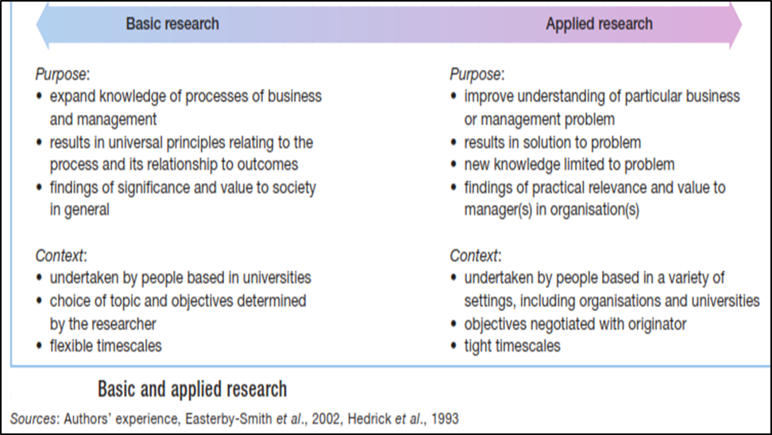
Important

Slide 13
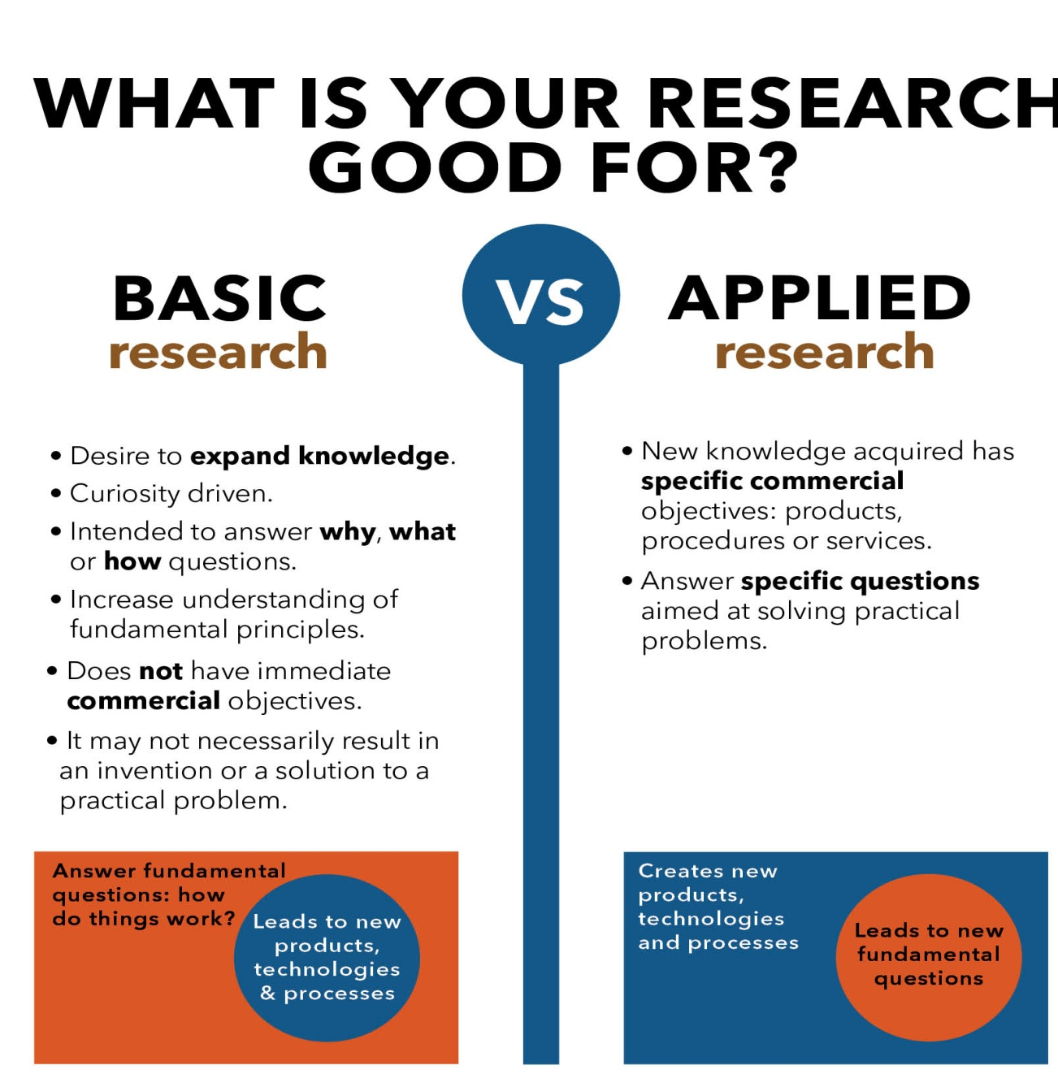

Slide 14
DEFINE BUSINESS RESEARCH
The application of the scientific method in searching for the truth about business phenomena.
These activities include defining business opportunities and problems, generating and evaluating ideas, monitoring performance, and understanding the business process.

Slide 15
THANK YOU

Slide 16
What does Business do?
Value creation – Benefit / Cost
Why some enterprise are successful and some fail?
They do not create value relative to competition
How do we ensure that we create value and not destroy value
Decide and Do or in another words
Sense and Respond
Decide correctly and Do it correctly
Sense correctly and Respond correctly

Slide 17
The entire game is centered around Deciding – Decision Making and Doing – implementing or another words
Sensing ( Decision making) and Responding (Doing)
So the thousand dollar question is how do we decide?

Slide 18
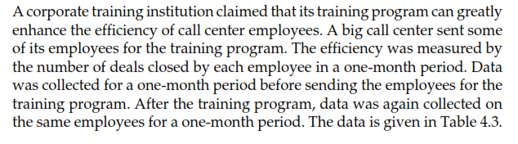
A corporate training institution claimed that its training program can greatly enhance the efficiency of call center employee. A big call center sent some of the employees for the training program. You are the head operations of the call center. Will you send your new employees for training. You have to decide.

